Slide 1
E6156 – Topics in SW Engineering (F23) Cloud Computing Lecture 8: EDA Examples, API GW, JWT, Pagination
© Donald F. Ferguson, 2023

Slide 2

Composition, Orchestration, Choreography Event Driven Architecture Examples
2 | E6156 – Topics in SW Engineering: Cloud Computing: Lecture 8 - EDA Examples, API-GW, JWT, Pagination © Donald F. Ferguson, 2023

Slide 3
Some Concepts
There are two concepts but without precise, universally agreed meanings.
Orchestration: “On the other hand, the orchestrator sends a command message to downstream microservices, telling it what operation to perform. After this microservice has performed the operation, it sends a reply message to the orchestrator. The orchestrator then processes the message and determines which next step to perform.”
Choreography: ”With choreography, you inform each part of the system of its job and let it work out the details, like dancers all finding their way and reacting to others around them in a ballet.”
There are many good overviews of the concepts”
https://ninetailed.io/blog/microservices-orchestration/
https://camunda.com/blog/2023/02/orchestration-vs-choreography/
https://docs.aws.amazon.com/prescriptive-guidance/latest/cloud-design-patterns/orchestration-choreography.html
https://betterprogramming.pub/microservice-orchestration-vs-choreography-5595b602fe3b

Slide 4
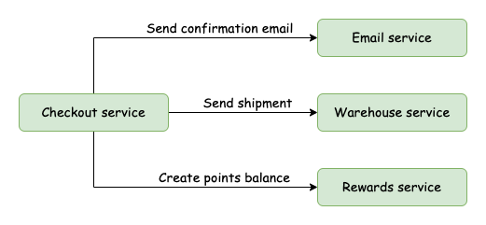
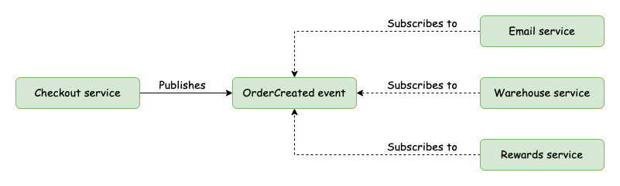
Orchestration and Choreography
Orchestration
Orchestration:
A N+1 service implements the composition logic.
Sends messages/events to other services to coordinate actions.
Choreography:
Each service is independent and knows its function.
Subscribes to and published events.
Choreography

Slide 5
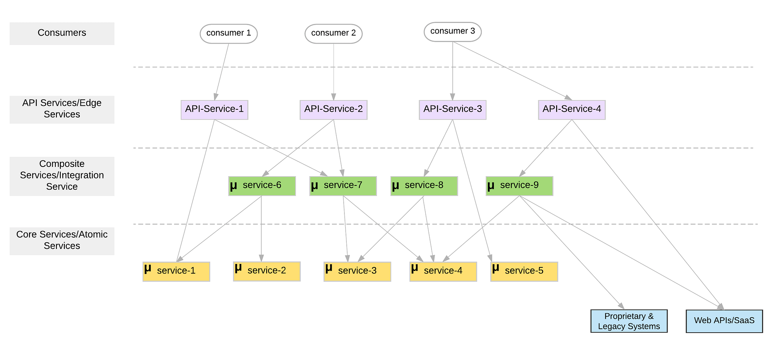
Microservice Layers

Slide 6
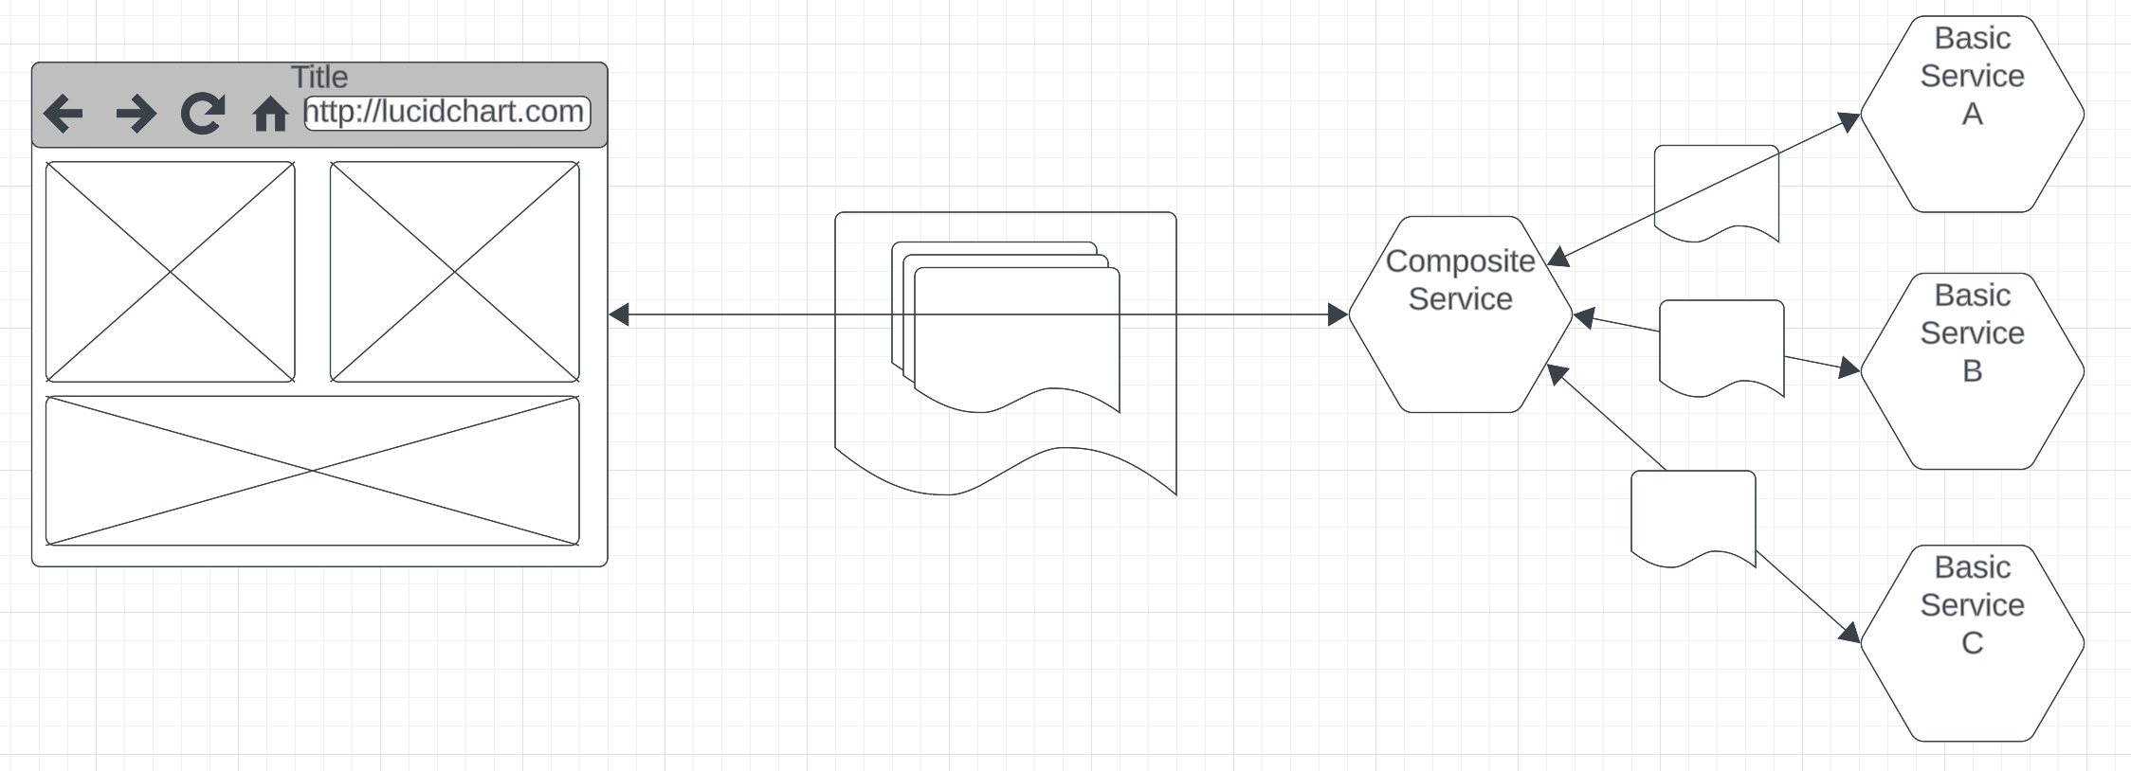
Composite Service
Users and applications think in terms of composite domain objects, e.g. a student is composed of: basic information, course registrations, projects, … …
UIs and other clients want to “retrieve the whole thing” and “update the whole thing.”
Implementing composition in the browser is a poor design.
In general, a lot of business logic in the browser/client is a poor idea. Prone to errors and fragile when things change.
Something has to handle the operations on the composite
Constraints between the objects.
Read or update failures of parts of the composite
Etc.
So, our next task is fleshing out implementation of the basic services functions and simple composite.

Slide 7
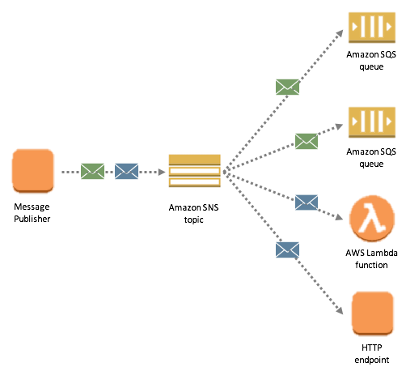
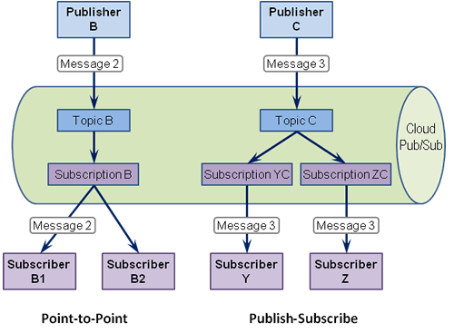
Pub/Sub
Reshow the topic, subscription, API keys, publication, webhook for the Discord example.

Slide 8
API Gateway JWT Authorization
8 | E6156 – Topics in SW Engineering: Cloud Computing: Lecture 8 - EDA Examples, API-GW, JWT, Pagination © Donald F. Ferguson, 2023

Slide 9
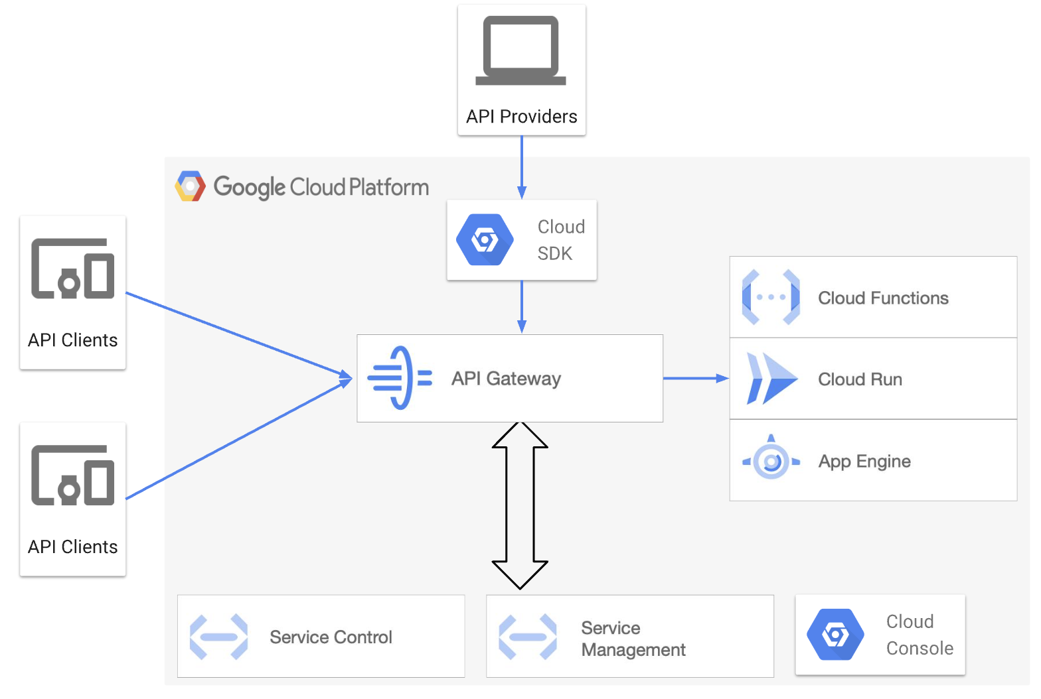
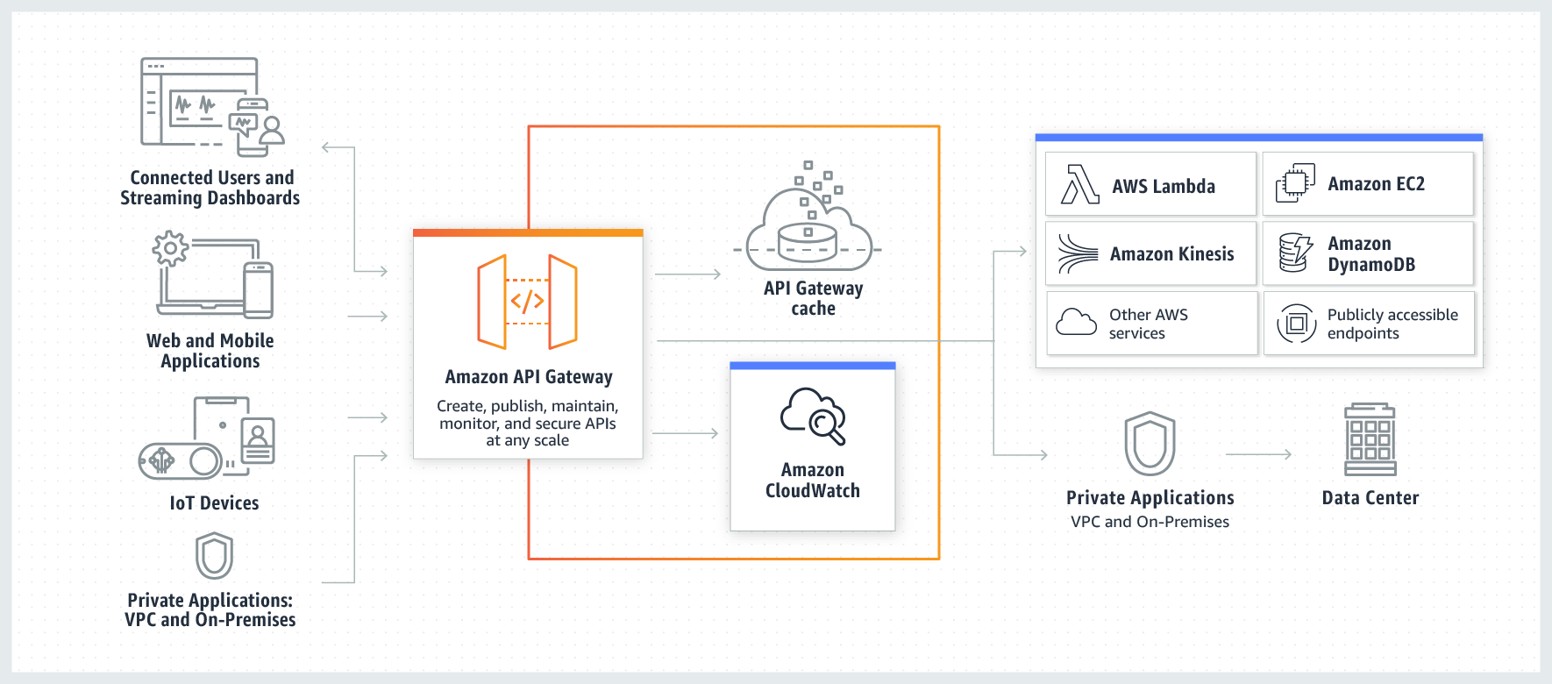
API Gateway
API Management and API Gateways are fundamental concepts.
Vastly simplifies changing microservice architectures, monitoring, enforcing security, throttling, versioning, … …
We will do some simple stuff with a gateway, starting with security.

Slide 10
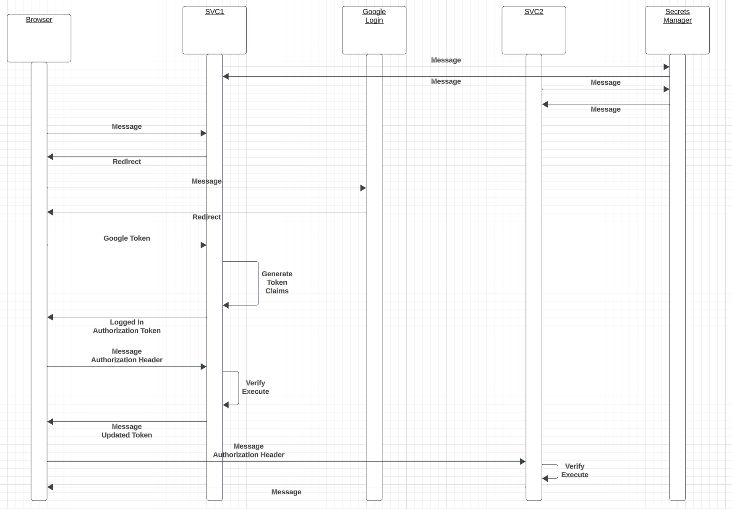
Login and Authorization Tokens
We have seen Google Login.
Forms the basics of authentication.
The server applications:
”Look up” user info in their database and systems.
Determine what operations the user can perform.
Generate a JWT Authorization containing signed claims.
Returns the token in an authorization header.
The client
“Saves” the token.
Attached to subsequent calls.
Servers can then authorize based on
Verifying the signature.
Checking that the client has a claim authorizing the operation.

Slide 11
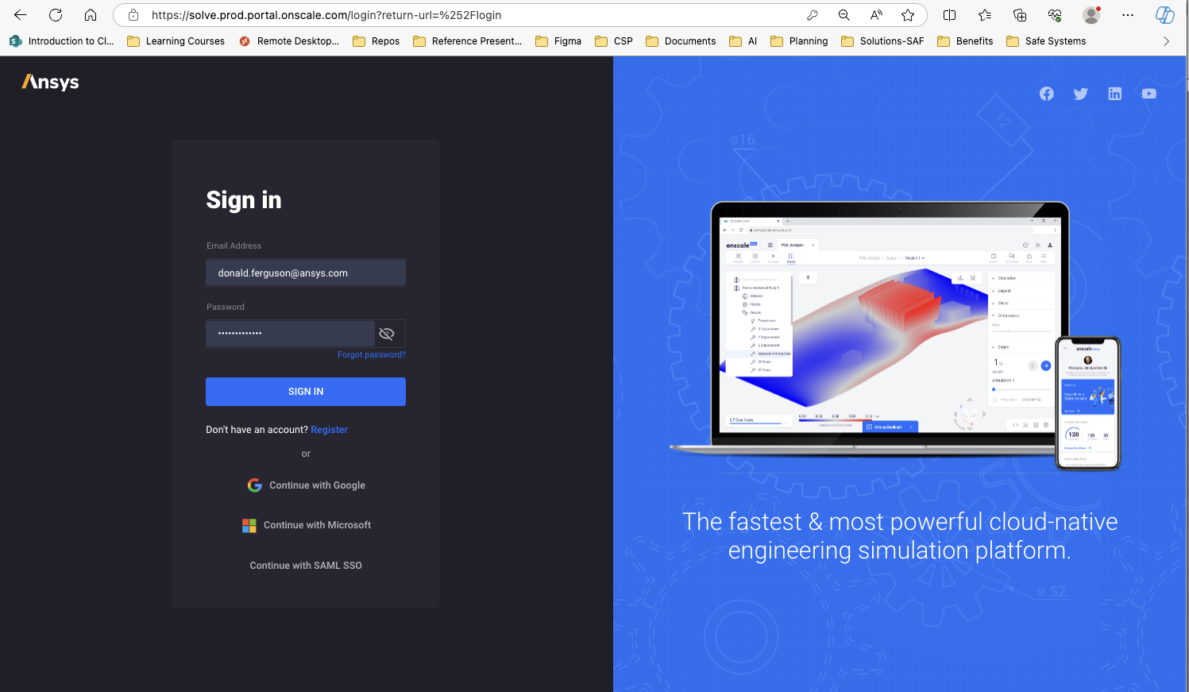
Real Example

Slide 12
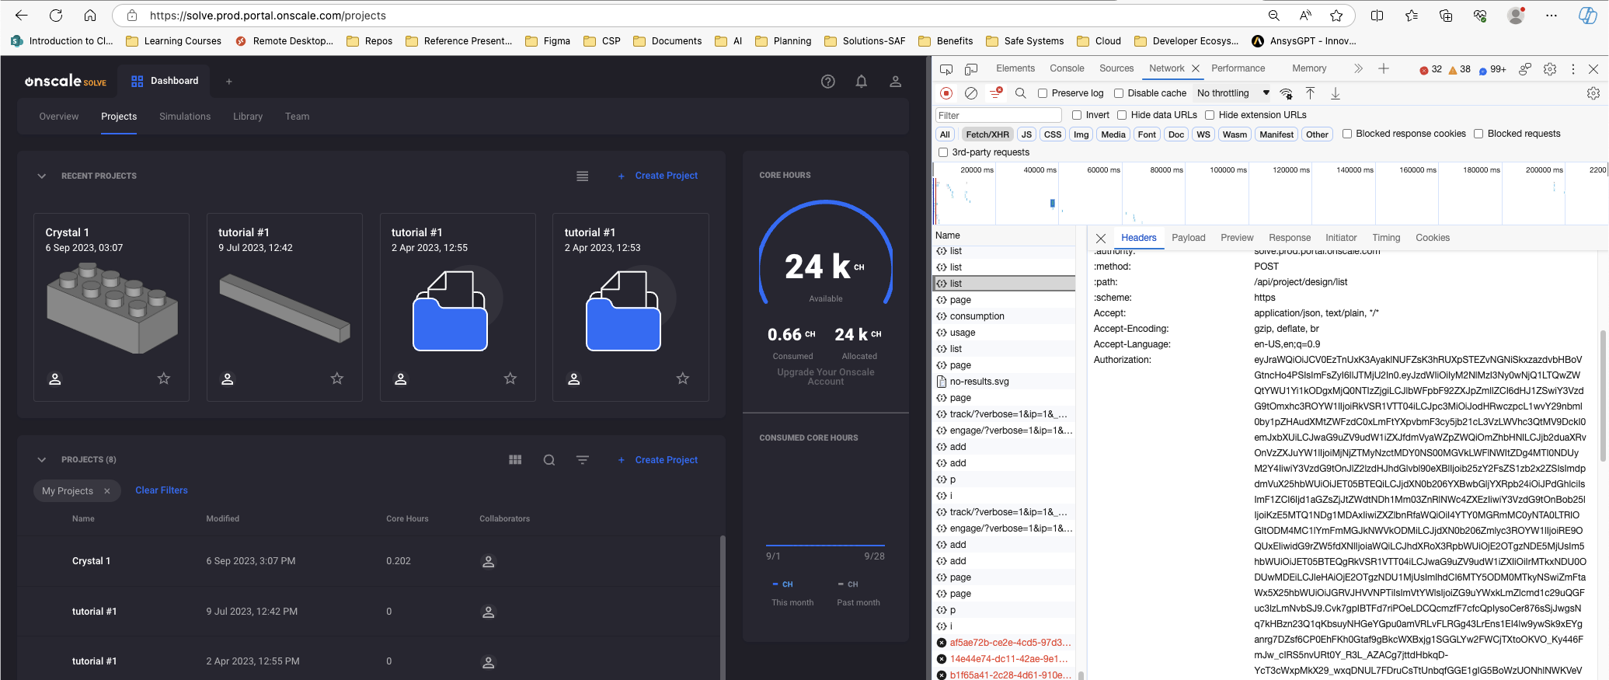
Real Example

Slide 13
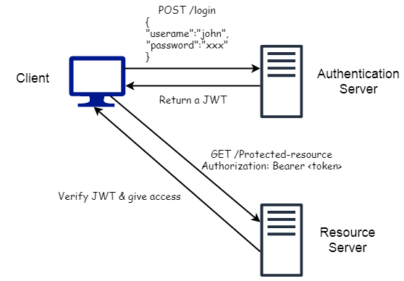
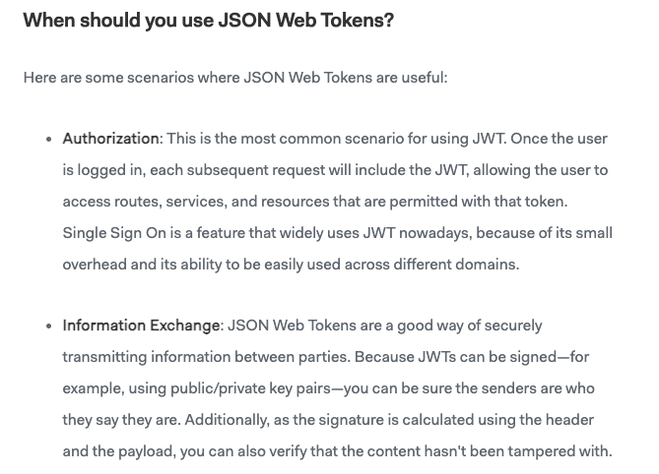
JWT
https://medium.com/swlh/all-you-need-to-know-about-json-web-token-jwt-8a5d6131157f

Slide 14
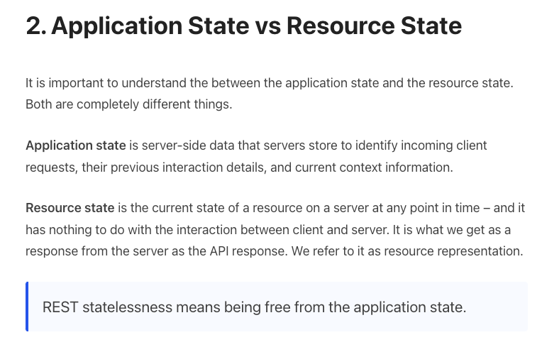
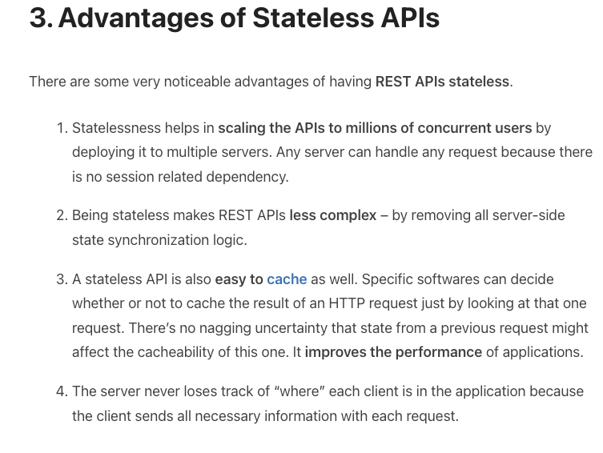
REST is Stateless (https://restfulapi.net/statelessness/)

Slide 15
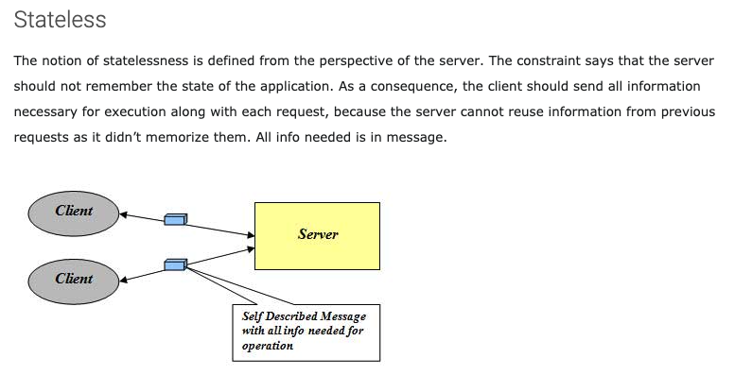
Stateless
http://mrbool.com/rest-architectural-elements-and-constraints/29339
Many platforms provided server-side functions to save session/conversation/application state.
Caching results of previous DB queries.
Current navigation position in a complex, multi-page application.
etc.
REST keeps the information in various headers or cookies. The browser re-provides the information on each request.
This is another use for JWT.

Slide 16
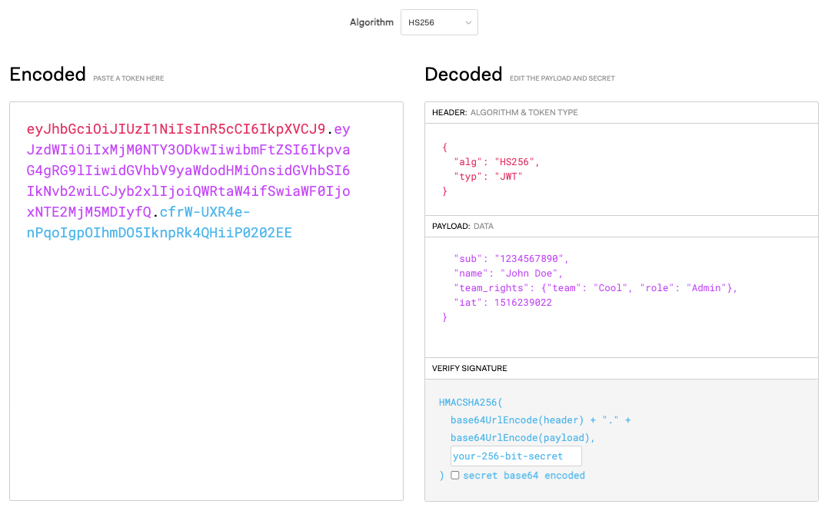
JWT.io

Slide 17
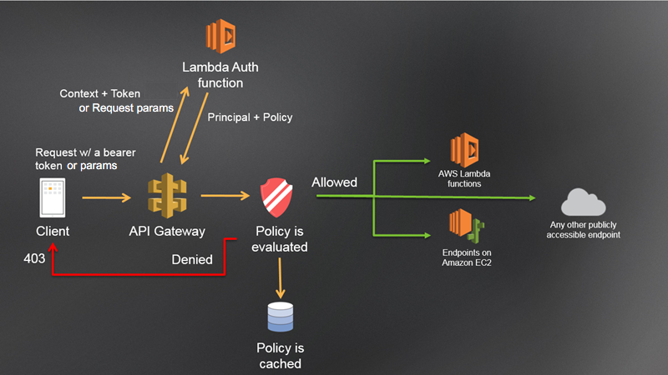
Lambda Authorizer

Slide 18
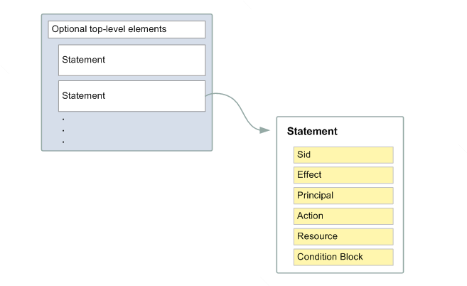
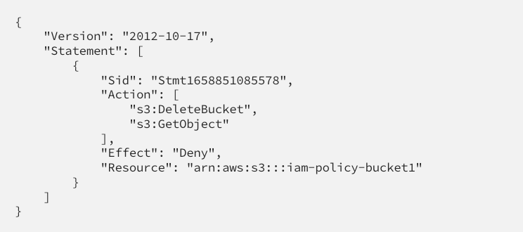
Example and Concepts
Show /Users/donaldferguson/Dropbox/0-F23-Projects/courseworks-lambda/authorizer/example_authorizer.py
The basic concepts in an authorization decision are:
Who is the user/identity?
What is the “ID” of the thing being touched?
What is the operation being performed?
This explains the structure of AWS policy documents (https://docs.aws.amazon.com/IAM/latest/UserGuide/access_policies.html).
Policies get attached to users, roles, groups, … …

Slide 19
Pagination
19 | E6156 – Topics in SW Engineering: Cloud Computing: Lecture 8 - EDA Examples, API-GW, JWT, Pagination © Donald F. Ferguson, 2023

Slide 20
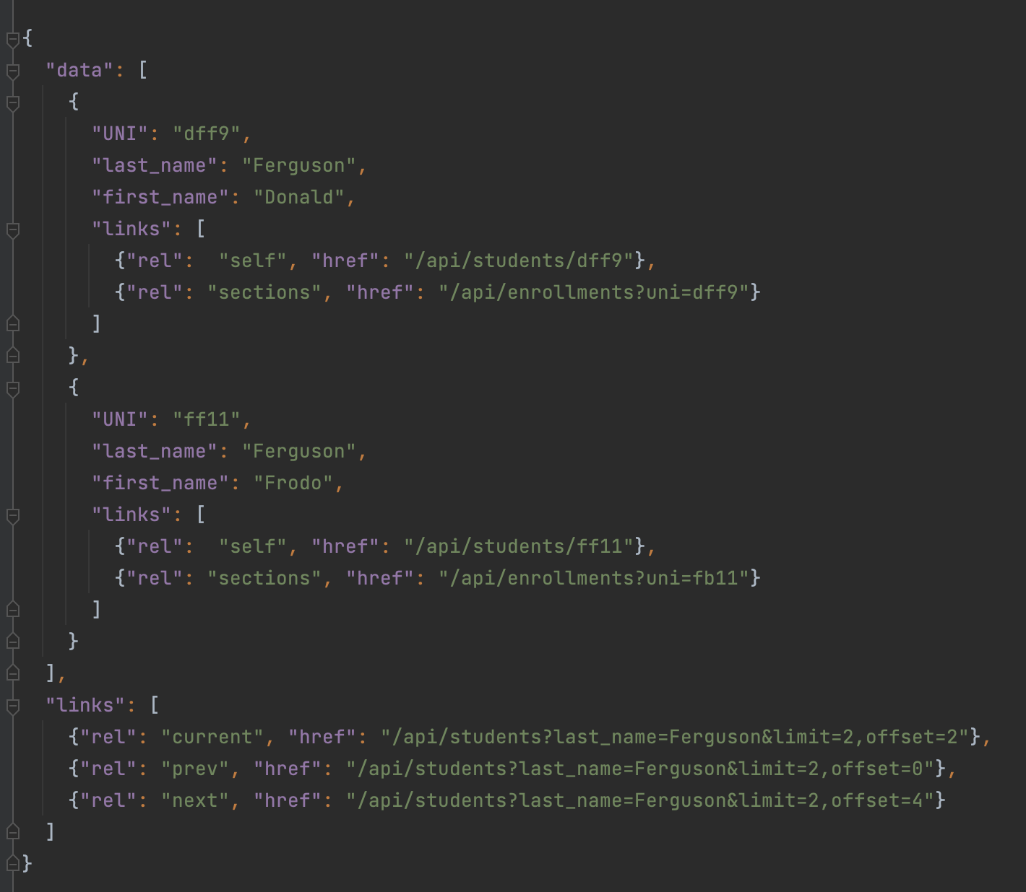
Pagination, Hyper Linked
Bad things may happen when a GET returns a huge result set.
A page is a window on the large result set.
limit is the no. of entries in the result set.
Client may specific a limit.
Server may have a default and/or maximum limit it allows.
There are many design patterns for implementing pagination.
Simplest is mirroring the SQL model:
limit=xxx&offset=yyy
The links section is the response should contain:
prev
next
current
May contain first and last.

Slide 21
/api/students
/api/students?last_name=Ferguson →
/api/students/dff9
/api/sections
/api/sections/10023
/api/enrollments
POST /api/erollments
Body {“uni”: “dff9”, “sections”: 10023}
Body {“student”: “/api/students/dff9”, “section”: “/api/sections/10023”}

Slide 22
Calling APIs
22 | E6156 – Topics in SW Engineering – Lecture 8: Service Composition, Calling APIs, Events
© Donald F. Ferguson, 2022

Slide 23
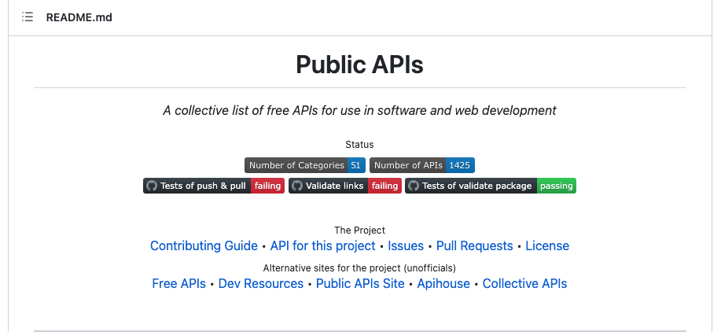
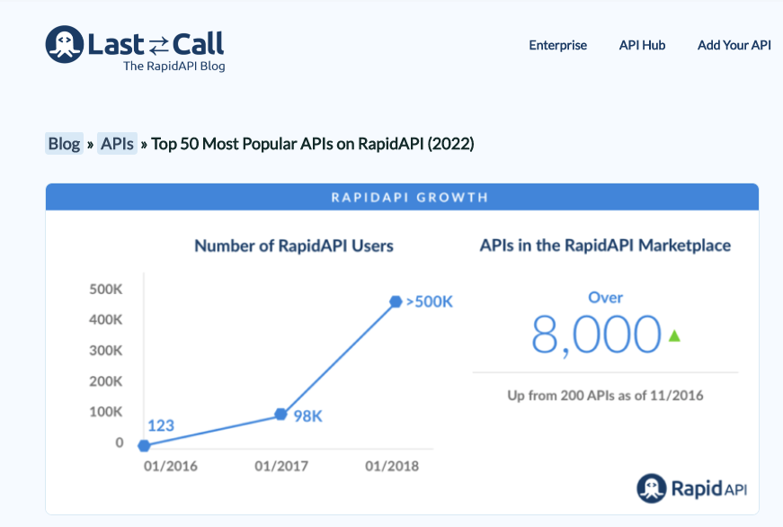
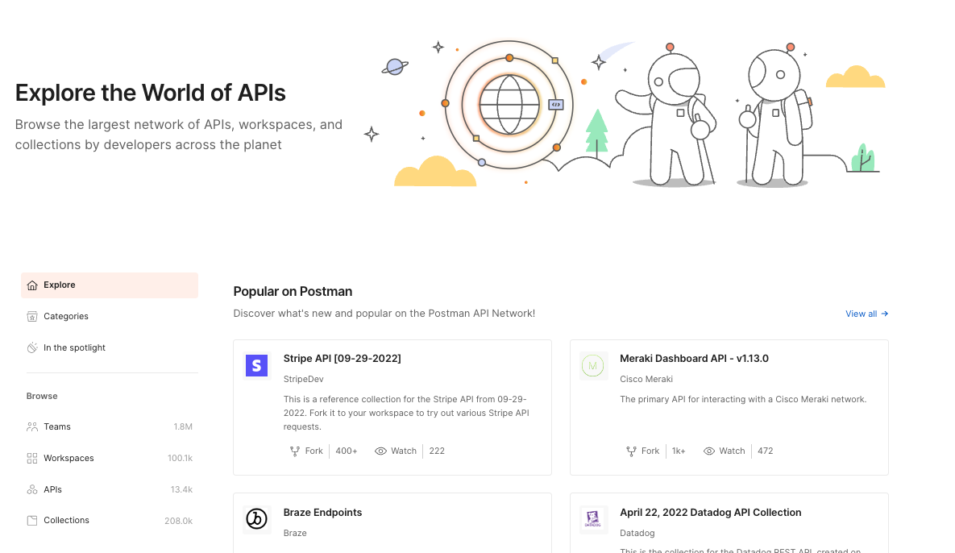
A World of APIs

Slide 24
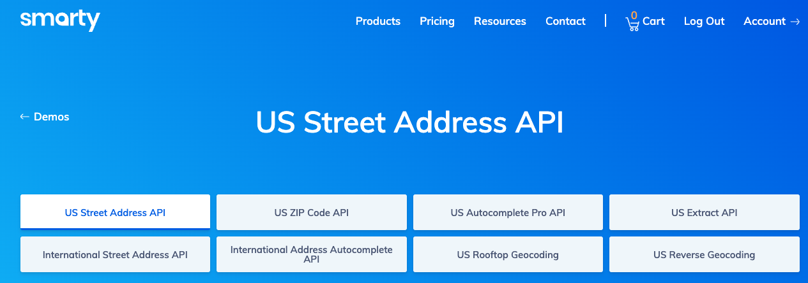
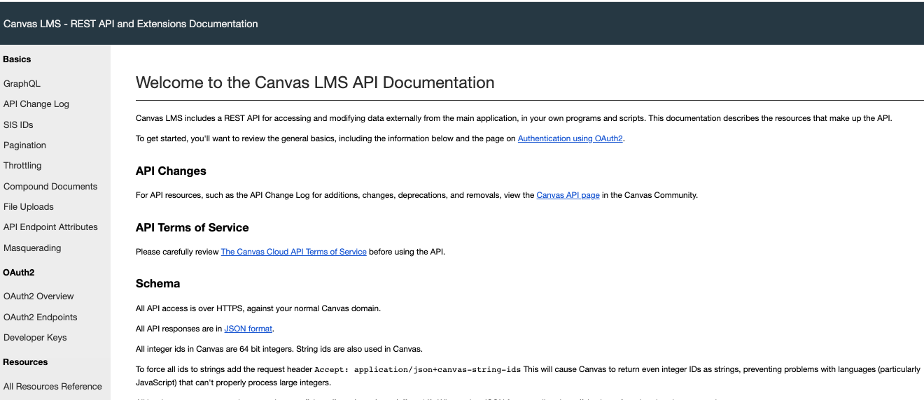
Two APIs I Use in My Project
Addresses:
People are really bad at entering mailing addresses.
520 w 120th st NYC
520 West 120 St New York, NY
… …
We want a canonical, verified representation.
CourseWorks
Students will access my web application to set up projects, teams, …
I want to verify that students are in the class, and keep list of students up to date.

Slide 25
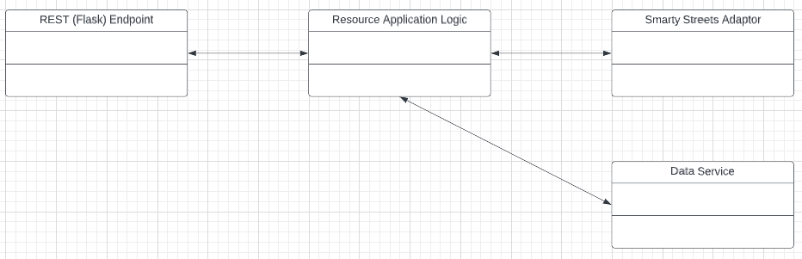
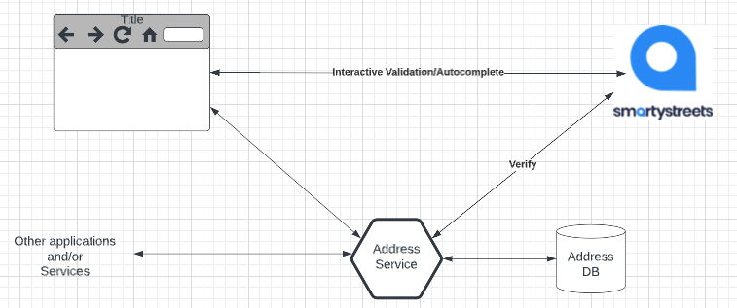
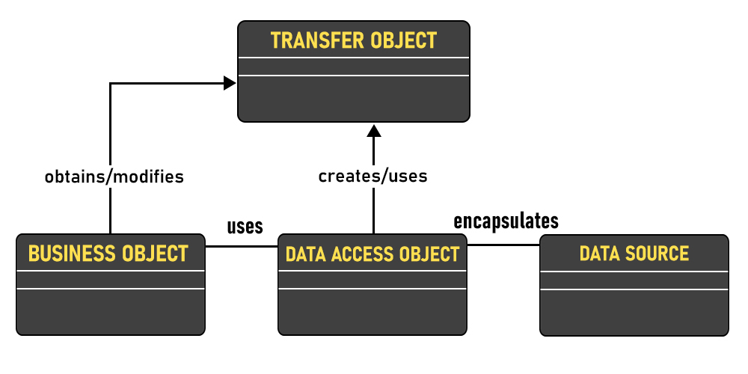
Address Example
Microservice Implementation
Receive JSON body in PUT/POST.
Call API to verify.
If verified, save in DB.
URL path is the delivery point
Zipcode
Zip plus 4
Delivery point
Use autocomplete functions to help users correctly enter addresses https://jsfiddle.net/smartystreets/j1Lq5say
But, … …
A microservice cannot assume that a valid UI is calling the service.
It must support any UI or endpoint authorized to call the service.
So, we will also validate in the microservice implementation.
Example code walkthrough and online tools.

Slide 26
Concepts

Slide 27
Synchronous versus Asynchronous
27 | E6156 – Topics in SW Engineering – Lecture 8: Service Composition, Calling APIs, Events
© Donald F. Ferguson, 2022

Slide 28
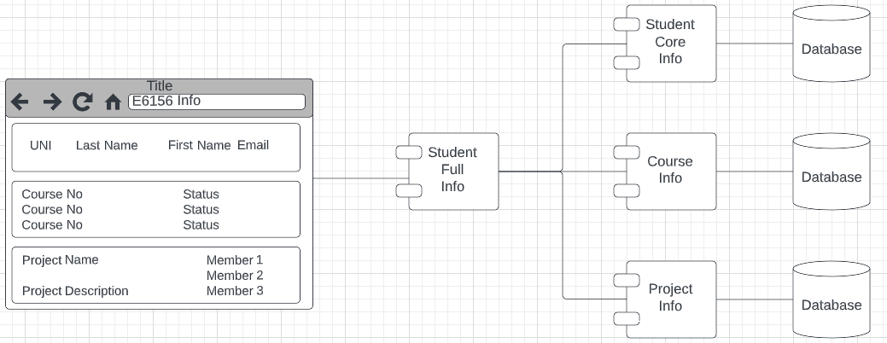
Synchronous versus Asynchronous
CRUD on composite service StudentFullInfo requires CRUD on 3 microservices.
There are two styles for calling the component (composed services)
Synchronous, one after another, waiting each time.
Asynchronous: Call all three in parallel, and ”gather the answer.”

Slide 29
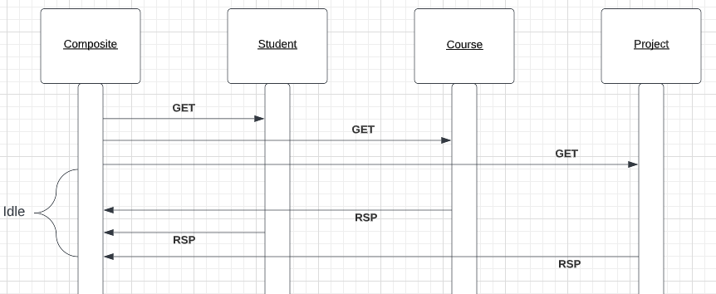
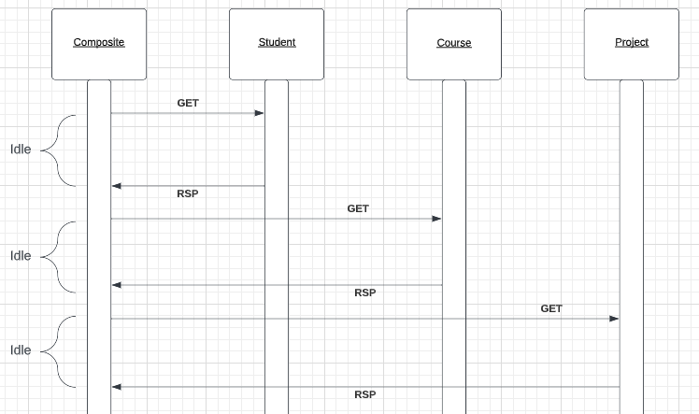
Synchronous versus Asynchronous
Asynchronous
Synchronous
Show code from:
call_urls_synch_asynch
async3
async_p_mysql
Async-python
av_requests
av_async_run
The elapsed time for calling synchronous is the sum of the calls’ response times.
The elapsed time for calling asynchronous is the maximum response time of the 3 calls.
Asynchronous:
Has better elapsed times and less “application is idle waiting” time, but
The logic is more complex, especially if the composite services has to “undo” some calls because others failed.

Slide 30
Concurrency
A running program executes in an operating system process. There are many approaches to concurrency:
Multiprocessing:
The system has several “active processes.”
Only one process is executing on a CPU (core) as a time.
The OS switches between processes when the running process performs a blocking operations, e.g. file IO, remote network call, ... ...
Multithreading:
There are several “active threads” within a process.
(Usually) Only one thread is executing on a CPU (core) at a time.
When the thread performs a blocking operation, the process continues to run but executes a different, ready thread.
Coroutines:
There is a single active thread within a process.
When a thread performs a blocking operation, the programming language runtime does weird internal stuff
Makes a copy of the current coroutines environment (call stack, ... ...)
Starts a ready coroutine by switching to its call stack and next statement.
The thread and process do not block.
A context switch is changing the currently running process, thread or task.
There is a performance overhead for a context switch.
Overhead(multiprocessing) >> Overhead(multithreading) >> Overhead(coroutines)

Slide 31
Threads, Promises, Asynch Functions, ... ...
https://medium.com/@amragaey/shortly-how-node-js-works-on-a-single-thread-763fda99f012
Callbacks
Incoming requests map to an event.
There is a single thread running application code associated with an event..
Long running calls get assigned to a separate worker thread, and register a callback.
Completion of an operation results in an event, which resumes the application via a callback.
https://en.wikipedia.org/wiki/Multithreading_(computer_architecture)
Multithreading
Thread #1 “blocks” for an IO or API call.
Process switches to “ready” thread #2

Slide 32
Service Composition
32 | E6156 – Topics in SW Engineering – Lecture 8: Service Composition, Calling APIs, Events
© Donald F. Ferguson, 2022

Slide 33
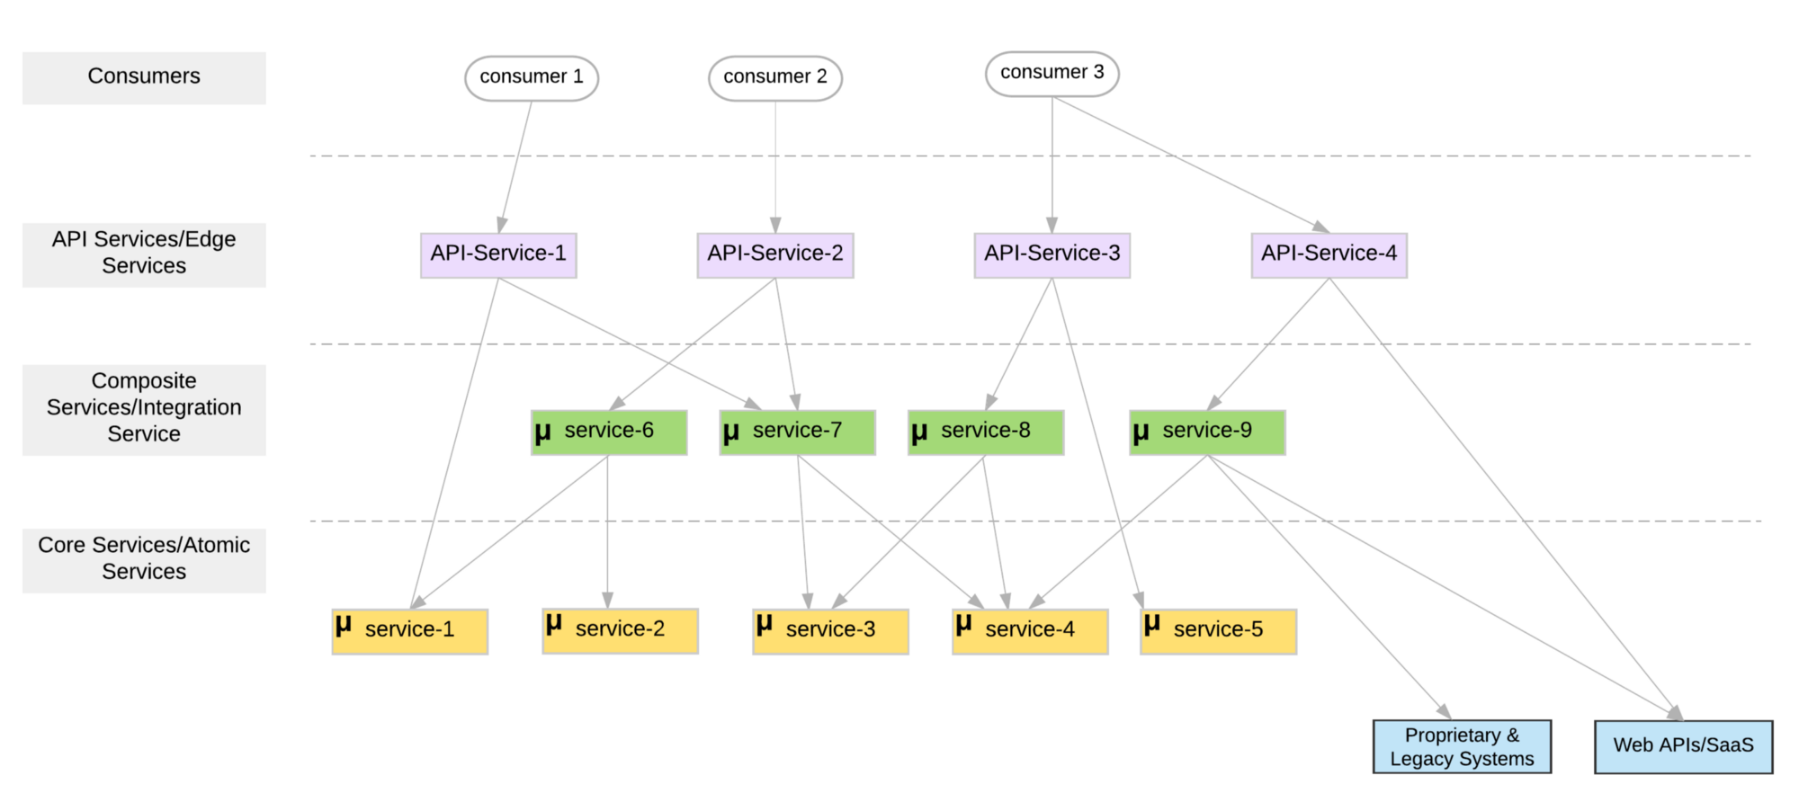
Microservice Layers

Slide 34
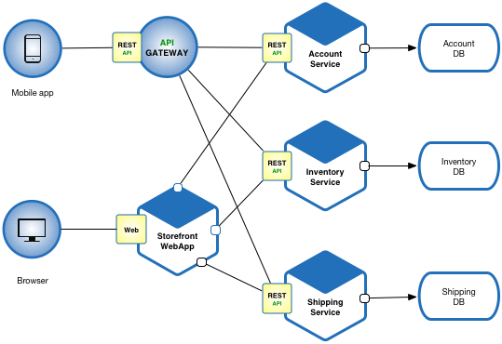
Another View

Slide 35
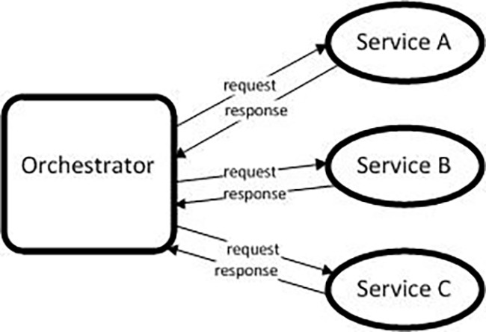
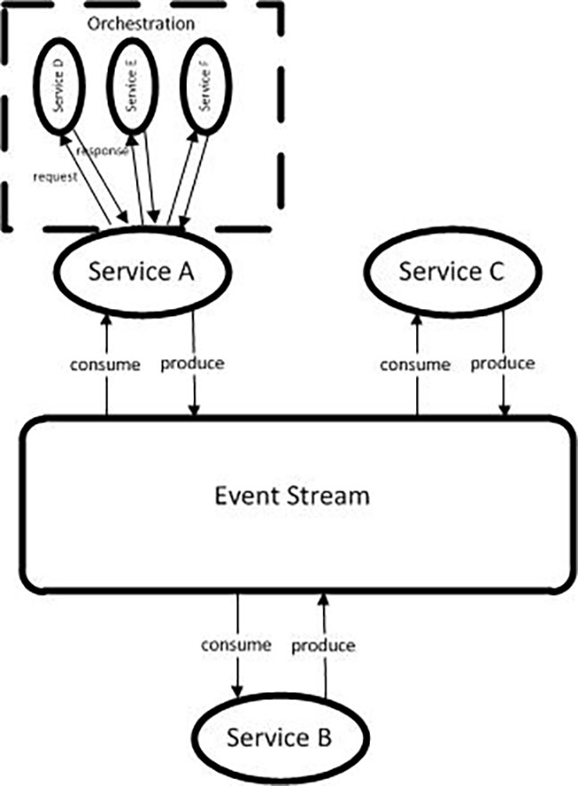
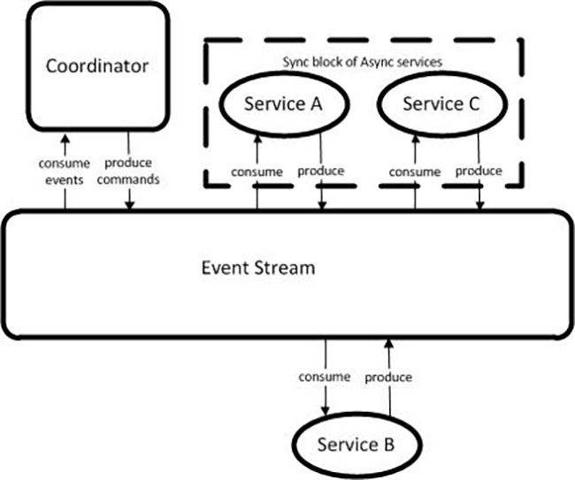
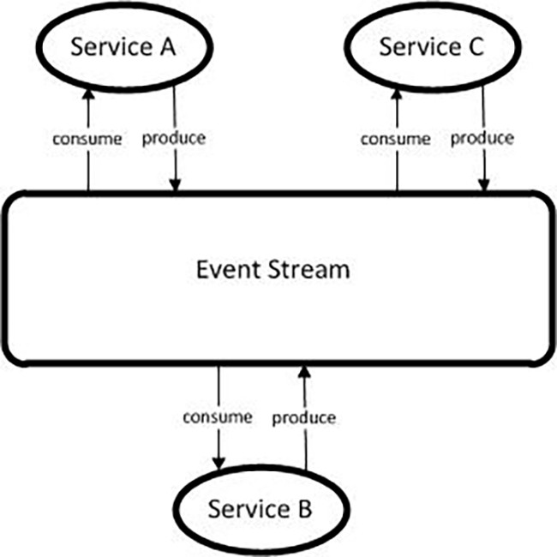
Models (https://medium.com/capital-one-tech/microservices-when-to-react-vs-orchestrate-c6b18308a14c)

Slide 36
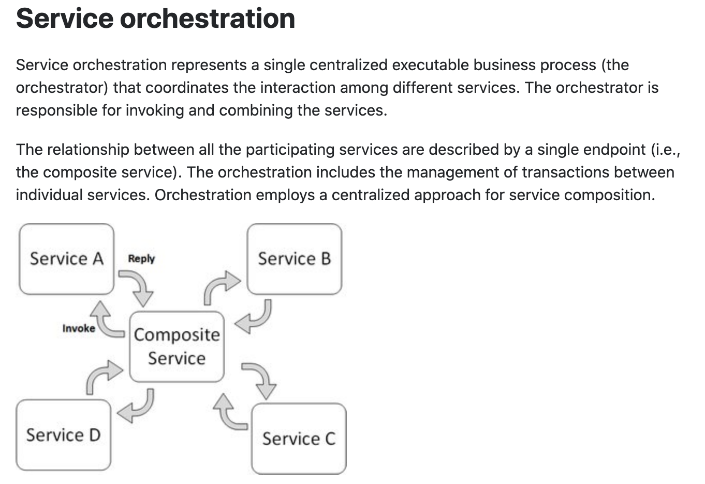
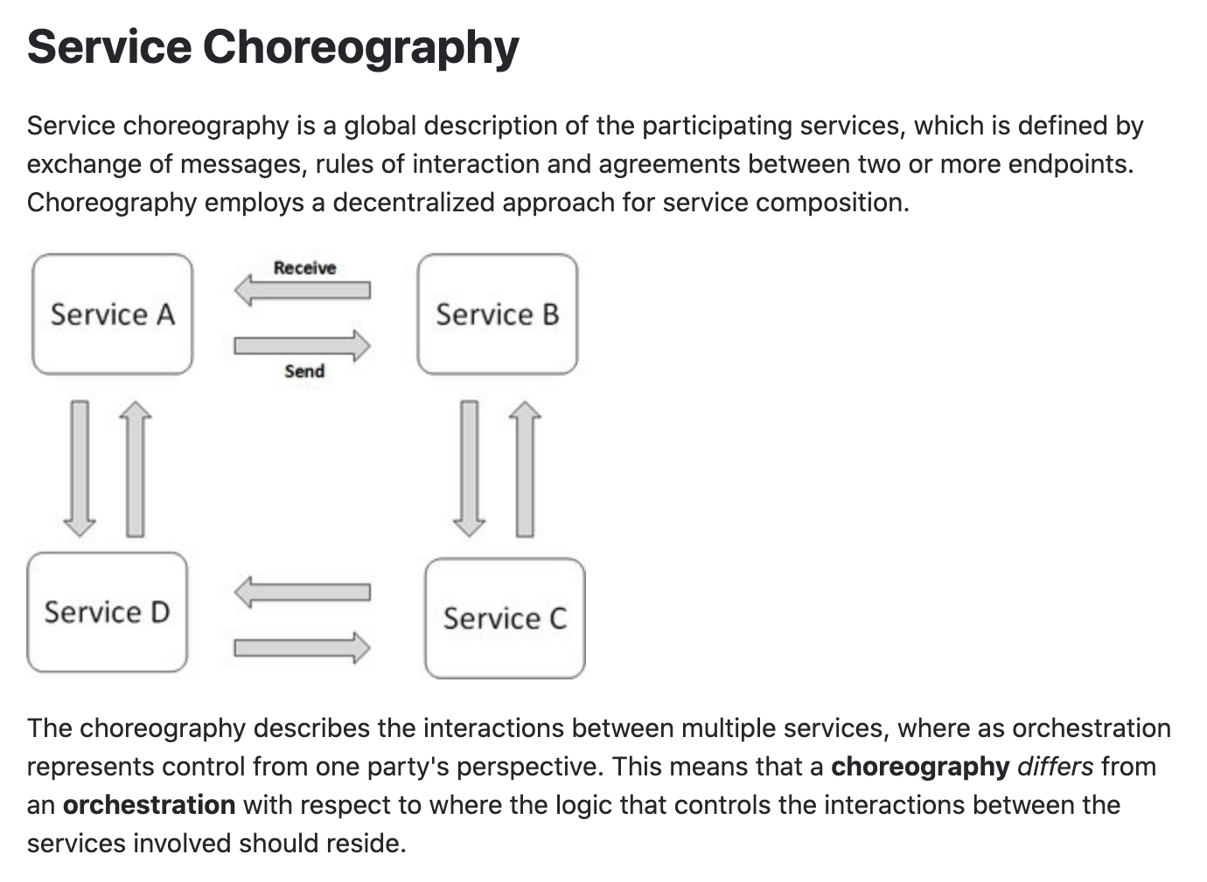
Concepts
These are not formally, rigorously defined terms.

Slide 37
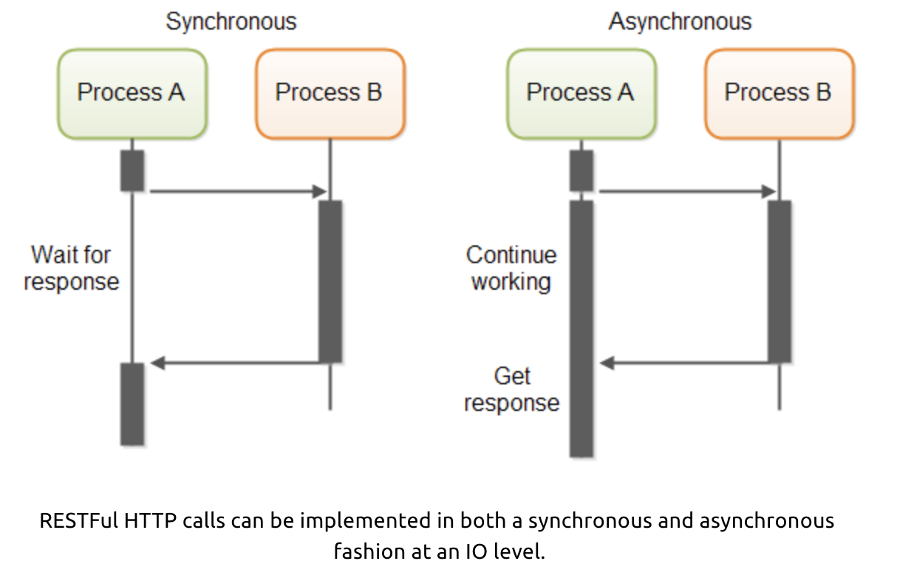
Service Orchestration/Composition
One call to a composite service
May drive calls to multiple other services.
Which in turn, may drive multiple calls to other services.
Synchronous (Wait) and calling one at a time, in order is
Inefficient
Fragile
... ...
Asynchronous has benefits but can result in complex code.

Slide 38
Middleware
38 | E6156 – Topics in SW Engineering – Lecture 8: Service Composition, Calling APIs, Events
© Donald F. Ferguson, 2022

Slide 39
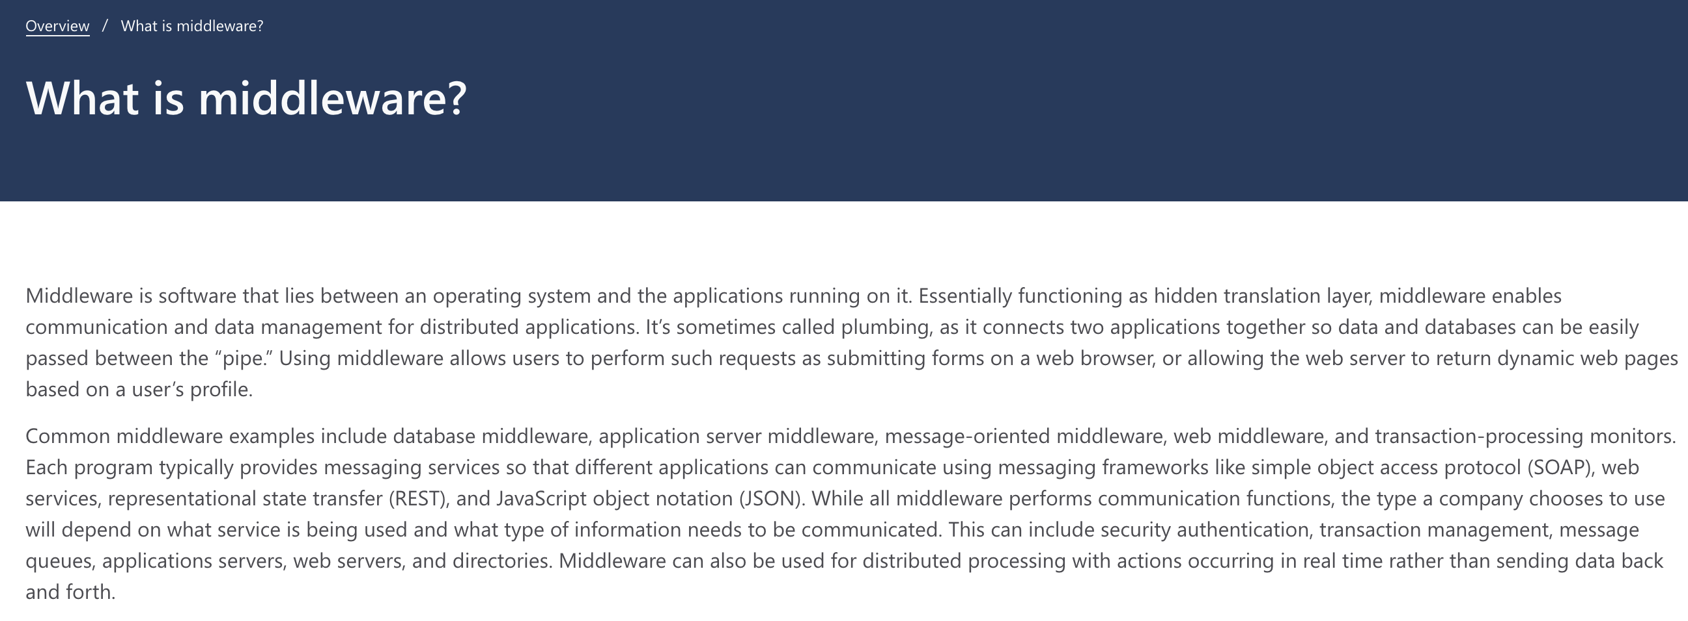
Middleware

Slide 40
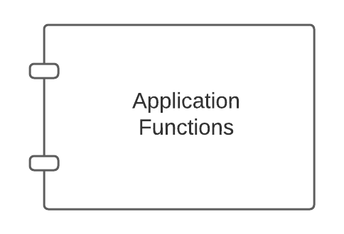
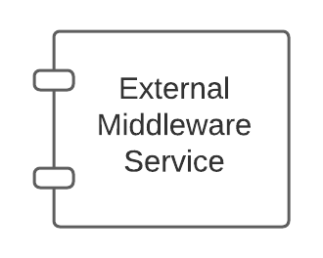
Middleware – Conceptual Model
Middleware:
Application might call directly, e.g. DB
May be implicitly called as part of request processing, e.g. logging.

Slide 41
FastAPI Middleware (https://medium.com/@saverio3107/mastering-middleware-in-fastapi-from-basic-implementation-to-route-based-strategies-d62eff6b5463)
What Does Middleware Do?
Incoming Request: When a request comes in, the middleware can examine and even modify parts of the request like cookies, headers, query parameters, etc., before it reaches the actual API service method. For example, it can validate the request, authenticate the user, or log the request details.
Outgoing Response: After the API service method has processed the request and generated a response, the middleware gets a chance to inspect and modify the response before it goes back to the client. This can include things like changing the response headers, transforming the content, and so on.

